Slide 1

Logout World
TRAVALOGUE FROM MANY AUTHOR
https://logout.world/

Slide 2
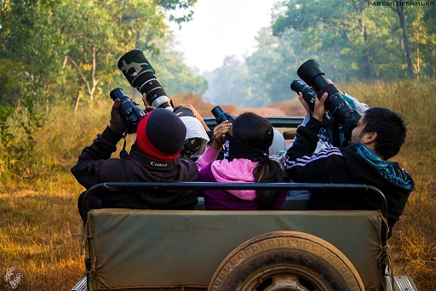
What We Do
Book Unique Trips
If you are a looking for new experiences on your trips, you will love us. Be it outdoors or adventure or bike rides, our hosts have unique trips to offer

Slide 3
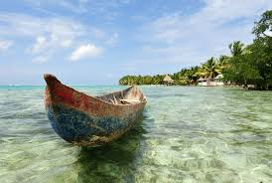
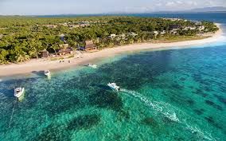
TRAVEL TO Madagascar
Madagascar , An oldest island on earth
Flora and fauna have evolved over 10 millions of years
There are 86 different species recognized
Apr, May, Oct, Nov are the best times to visit.

Slide 4
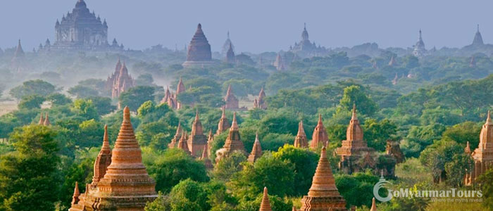
EXPERINCE AT BAGAN,BURMA
2,217 Ancient stone temples are at Bagan
From the 11th to 13th, it is the biggest Religious centre in World
Bagan is 140km south-west of Mandalay
Its best toured by bicycle or by horse and cart.

Slide 5
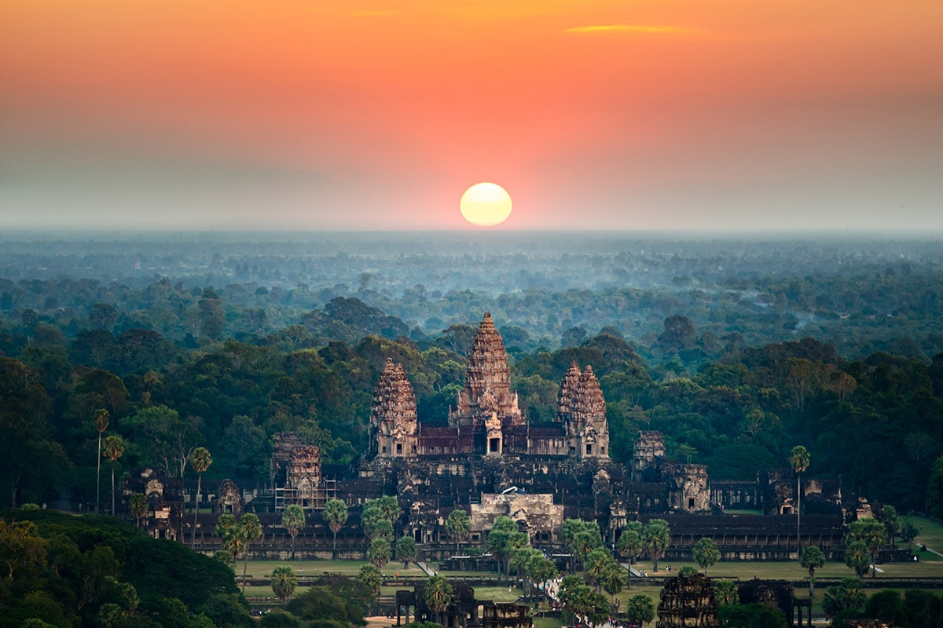
TRAVEL TO CAMBODIA
Angkor Wat is largest religious monument in the world
It was originally constructed as a Hindu temple dedicated to the god Vishnu
It was built by the Khmer King Suryavarman II
ANGKOR WAT

Slide 6
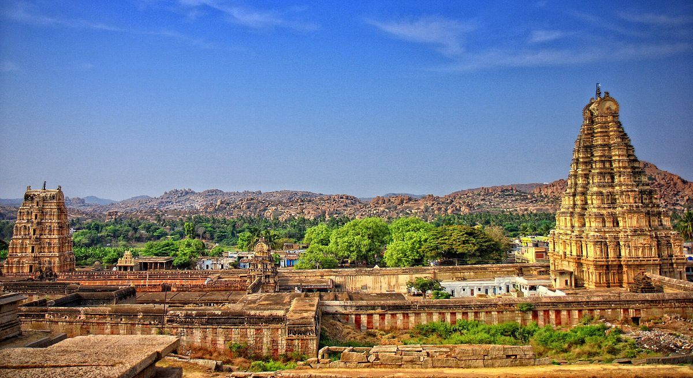
NEXT VISIT TO HAMPI
Hampi became the capital of the Hindu Vijayanagar Empire
Hampi-Vijayanagara was the world's second-largest medieval-era city after Beijing
VIRUPAKSHA TEMPLE
The main temple consists of a sanctum, three ante chambers, a pillared hall and an open pillared hall

Slide 7


